Slide 1


Exposure Java 2015
AP®CS Edition
Chapter 10 Slides
Focus on OOP: Class Interaction
PowerPoint Presentation
created by:
Mr. John L. M. Schram
and Mr. Leon Schram
Authors of Exposure Java

Slide 2
Section 10.1
Introduction

Slide 3
OOP Review
Object Oriented Programming (OOP) is a style of programming that incorporates these 3 features:
Encapsulation
Polymorphism
Class Interaction

Slide 4
Class Interaction
There are 3 types of class interaction.
One is composition, which is demonstrated in the first 15 program examples.
Another is inheritance, which is demonstrated in the next 10 program examples.
The third is utility classes which is explained on the next slide.

Slide 5


Utility Classes
You have actually been working
with Utility classes for a while.
These are classes which are not
used to create objects, but still
contain several useful methods.
Java’s Math class and our own Utility class are both perfect examples of this.

Slide 6
Inheritance
Inheritance is the process of using features (both attributes and methods) from an existing class.
The existing class is called the superclass and the new class, which inherits the superclass features, is called the subclass.
superclass: Car
subclasses:
Truck, Limo & Racecar

Slide 7
“Is-A” and “Has-A”
The creation of new classes with the help of existing classes makes an important distinction between two approaches.
An "is-a" relationship declares a new class as a special “new-and-improved” case of an existing class. In Geometry, a parallelogram "is-a" quadrilateral with special properties.
A “has-a” relationship declares a new class composed of an existing class or classes. A line "has" points, a square "has" lines, and a cube "has" squares.
A truck "is-a" car, but it "has-an" engine.

Slide 8

Composition
Composition occurs when the data attributes of one class are objects of another class.
You do NOT say “A Car is-an Engine” or “A Car is 4 tires” but you DO say “A Car has-an Engine” & “A car has 4 tires.”
class: Car
Contained
Objects:
1 Engine
4 Tires

Slide 9
Inheritance vs. Composition
In computer science an "is-a" relationship is called inheritance | and a "has-a" relationship is called composition.
“A TireSwing is-a Swing”. | “A TireSwing has-a Tire.”
Subclass:
TireSwing
Superclass:
Swing
Contained
class: Tire

Slide 10
Section 10.2
The Point class

Slide 11
// Java1001.java
// This program introduces the first stage of <Point> class, which
// stores the (X,Y) values of one coordinate graphics location.
public class Java1001
{
public static void main(String[] args)
{
Point point = new Point();
System.out.println("Point at (" + point.getX() + "," + point.getY() + ")");
}
}
class Point
{
int x;
int y;
public Point() { x = 0; y = 0; }
public int getX() { return x; }
public int getY() { return y; }
}
Point at (0,0)

Slide 12
// Java1002.java
// The <Point> class is improved with
// a second "overloaded" constructor.
public class Java1002
{
public static void main(String[] args)
{
Point point1 = new Point();
System.out.println("Point1 at (" +
point1.getX() + "," + point1.getY() + ")");
Point point2 = new Point(500,300);
System.out.println("Point2 at (" +
point2.getX() + "," + point2.getY() + ")");
}
}
Point1 at (0,0)
Point2 at (500,300)

Slide 13
class Point
{
int x;
int y;
public Point() { x = 0; y = 0; }
public Point(int x, int y)
{
this.x = x;
this.y = y;
}
public int getX() { return x; }
public int getY() { return y; }
}

Slide 14
// Java1003.java
// The <Point> class is now used in a graphics program.
import java.awt.*;
import java.applet.*;
public class Java1003 extends Applet
{
public void paint(Graphics g)
{
Point point1 = new Point();
g.setColor(Color.red);
g.fillRect(point1.getX(),point1.getY(),400,300);
Point point2 = new Point(300,200);
g.setColor(Color.blue);
g.fillRect(point2.getX(),point2.getY(),450,200);
}
}

Slide 15
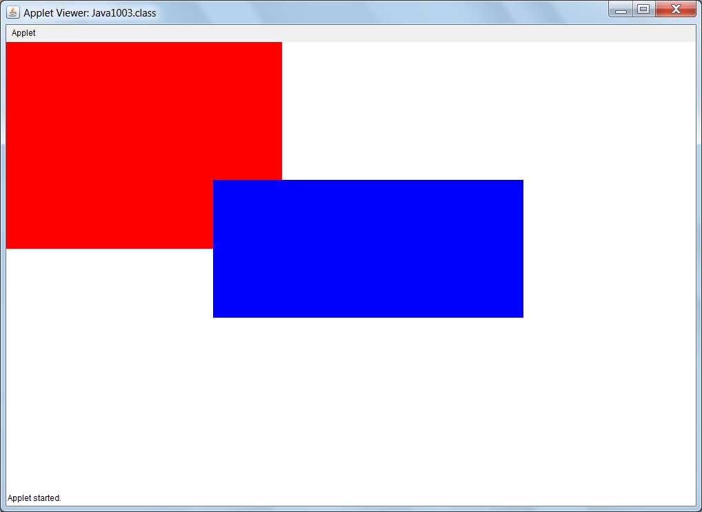

Slide 16
// Java1004.java
// This program adds two set methods to the <Point> class.
import java.awt.*;
import java.applet.*;
public class Java1004 extends Applet
{
public void paint(Graphics g)
{
Point point1 = new Point();
g.setColor(Color.red);
g.fillRect(point1.getX(),point1.getY(),400,300);
Point point2 = new Point(300,200);
g.setColor(Color.blue);
g.fillRect(point2.getX(),point2.getY(),450,200);
point2.setX(100);
point2.setY(100);
g.setColor(Color.green);
g.fillRect(point2.getX(),point2.getY(),500,500);
}
}

Slide 17
class Point
{
int x;
int y;
public Point() { x = 0; y = 0; }
public Point(int x, int y)
{
this.x = x;
this.y = y;
}
public int getX() { return x; }
public int getY() { return y; }
public void setX(int x) { this.x = x; }
public void setY(int y) { this.y = y; }
}

Slide 18
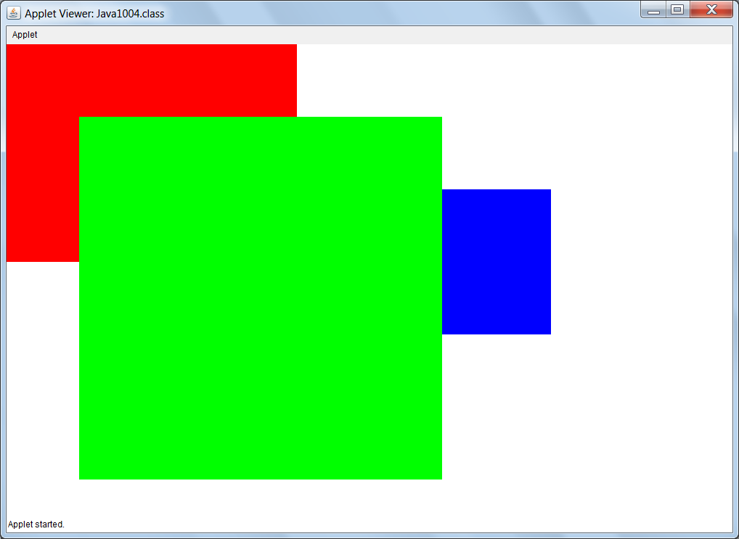

Slide 19
// Java1005.java
// The <Point> class is placed in an external "stand-alone" file.
// This follows the general rule of "one class, one file.“
import java.awt.*;
import java.applet.*;
public class Java1004 extends Applet
{
public void paint(Graphics g)
{
Point point1 = new Point();
g.setColor(Color.red);
g.fillRect(point1.getX(),point1.getY(),400,300);
Point point2 = new Point(300,200);
g.setColor(Color.blue);
g.fillRect(point2.getX(),point2.getY(),450,200);
point2.setX(100);
point2.setY(100);
g.setColor(Color.green);
g.fillRect(point2.getX(),point2.getY(),500,500);
}
}

Slide 20
// Point.java
// This is the completed <Point> class kept in its own file.
// This class is now ready to be used by classes external to this file.
// More methods could be added, but this is a basic functional set.
public class Point
{
int x;
int y;
public Point() { x = 0; y = 0; }
public Point(int x, int y)
{
this.x = x;
this.y = y;
}
public int getX() { return x; }
public int getY() { return y; }
public void setX(int x) { this.x = x; }
public void setY(int y) { this.y = y; }
}

Slide 21
Section 10.3
The Trunk class

Slide 22

// Java1006.java
// This program introduces the <Trunk> class.
// The program displays a tree trunk using only
// a default constructor.
import java.awt.*;
import java.applet.*;
public class Java1006 extends Applet
{
public void paint(Graphics g)
{
Trunk trunk = new Trunk();
trunk.drawTrunk(g);
}
}

Slide 23
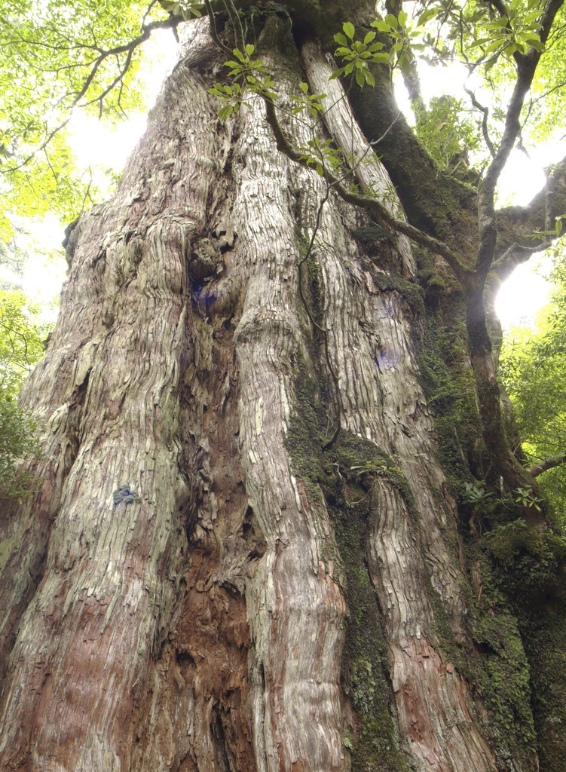
class Trunk
{
private int trunkStartX;
private int trunkStartY;
private int trunkHeight;
private int trunkWidth;
private Color trunkColor;
public Trunk()
{
trunkStartX = 0;
trunkStartY = 0;
trunkHeight = 320;
trunkWidth = 80;
trunkColor = Color.black;
}
public void drawTrunk(Graphics g)
{
g.setColor(trunkColor);
g.fillRect(trunkStartX,trunkStartY,trunkWidth,trunkHeight);
}
}

Slide 24
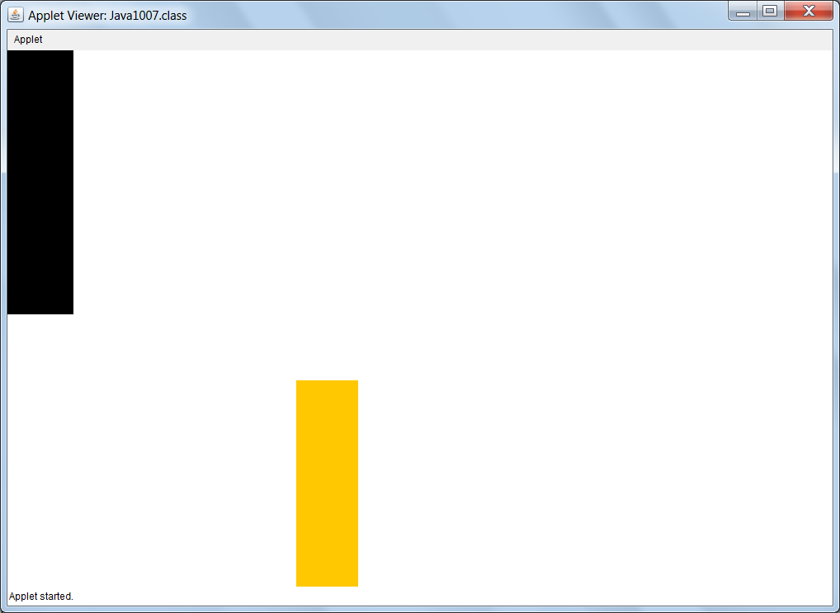
// Java1007.java
// The <Trunk> class now uses a overloaded constructor that
// allows construction with the trunk's location, height and color.
import java.awt.*;
import java.applet.*;
public class Java1007 extends Applet
{
public void paint(Graphics g)
{
Trunk trunk1 = new Trunk();
Trunk trunk2 = new Trunk(350,400,75,300,Color.orange);
trunk1.drawTrunk(g);
trunk2.drawTrunk(g);
}
}

Slide 25
class Trunk
{
private int trunkStartX;
private int trunkStartY;
private int trunkHeight;
private int trunkWidth;
private Color trunkColor;
public Trunk(int tX, int tY, int tW, int tH, Color tC)
{
trunkStartX = tX;
trunkStartY = tY;
trunkHeight = tH;
trunkWidth = tW;
trunkColor = tC;
}
public void drawTrunk(Graphics g)
{
g.setColor(trunkColor);
g.fillRect(trunkStartX,trunkStartY,trunkWidth,trunkHeight);
}
}
public Trunk()
{
trunkStartX = 0;
trunkStartY = 0;
trunkHeight = 320;
trunkWidth = 80;
trunkColor = Color.black;
}

Slide 26

// Java1008.java
// This <Trunk> class uses "has-a" composition.
// In this example, a <Point> object is constructed
// outside the <Trunk> class and passed as parameter
// to construct a <Trunk> object.
import java.awt.*;
import java.applet.*;
public class Java1008 extends Applet
{
public void paint(Graphics g)
{
Trunk trunk1 = new Trunk();
trunk1.drawTrunk(g);
Point point2 = new Point(350,400);
Trunk trunk2 = new Trunk(point2,75,300,Color.orange);
trunk2.drawTrunk(g);
}
}

Slide 27
class Trunk
{
private Point trunkStart;
private int trunkHeight;
private int trunkWidth;
private Color trunkColor;
public Trunk(Point tS,int tW, int tH, Color tC)
{
trunkStart = tS;
trunkHeight = tH;
trunkWidth = tW;
trunkColor = tC;
}
public void drawTrunk(Graphics g)
{
g.setColor(trunkColor);
g.fillRect(trunkStart.getX(),trunkStart.getY(),trunkWidth,trunkHeight);
}
}
public Trunk()
{
trunkStart = new Point(0,0);
trunkHeight = 320;
trunkWidth = trunkHeight/4;
trunkColor = Color.black;
}

Slide 28
// Java1009.java
// The <Trunk> class is now complete with four
// "get" methods and four "set" methods.
import java.awt.*;
import java.applet.*;
public class Java1009 extends Applet
{
public void paint(Graphics g)
{
Trunk trunk1 = new Trunk();
trunk1.drawTrunk(g);
Point point2 = new Point(350,400);
Trunk trunk2 = new Trunk(point2,75,300,Color.red);
trunk2.drawTrunk(g);
}
}

Slide 29
class Trunk
{
private Point trunkStart;
private int trunkHeight;
private int trunkWidth;
private Color trunkColor;
public Trunk()
{
trunkStart = new Point(0,0);
trunkHeight = 320;
trunkWidth = trunkHeight/4;
trunkColor = Color.black;
}
public Trunk(Point tS,int tW, int tH, Color tC)
{
trunkStart = tS;
trunkHeight = tH;
trunkWidth = tW;
trunkColor = tC;
}

Slide 30
public Point getTrunkStart() { return trunkStart; }
public int getTrunkHeight() { return trunkHeight; }
public int getTrunkWidth() { return trunkWidth; }
public Color getTrunkColor() { return trunkColor; }
public void setTrunkStart(Point tP) { trunkStart = tP; }
public void setTrunkHeight(int tH) { trunkHeight = tH; }
public void setTrunkWidth(int tW) { trunkWidth = tW; }
public void setTrunkColor(Color tC) { trunkColor = tC; }
public void drawTrunk(Graphics g)
{
g.setColor(trunkColor);
g.fillRect(trunkStart.getX(),trunkStart.getY(),trunkWidth,trunkHeight);
}
}

Slide 31
// Java1010.java
// The <Trunk> class can now join the <Point> class
// as a stand-alone class ready to be used by other classes.
import java.awt.*;
import java.applet.*;
public class Java1010 extends Applet
{
public void paint(Graphics g)
{
Trunk trunk1 = new Trunk();
trunk1.drawTrunk(g);
Point point2 = new Point(350,400);
Trunk trunk2 = new Trunk(point2,75,300,Color.red);
trunk2.drawTrunk(g);
}
}

Slide 32
// Trunk.java
// This is the completed <Trunk> class kept in its own file.
// This class is now ready to be used by classes external to this file.
import java.awt.*;
public class Trunk
{
private Point trunkStart;
private int trunkHeight;
private int trunkWidth;
private Color trunkColor;
public Trunk()
{
trunkStart = new Point(0,0);
trunkHeight = 320;
trunkWidth = trunkHeight/4;
trunkColor = Color.black;
}

Slide 33
public Trunk(Point tS,int tW, int tH, Color tC)
{
trunkStart = tS;
trunkHeight = tH;
trunkWidth = tW;
trunkColor = tC;
}
public Point getTrunkStart() { return trunkStart; }
public int getTrunkHeight() { return trunkHeight; }
public int getTrunkWidth() { return trunkWidth; }
public Color getTrunkColor() { return trunkColor; }
public void setTrunkStart(Point tP) { trunkStart = tP; }
public void setTrunkHeight(int tH) { trunkHeight = tH; }
public void setTrunkWidth(int tW) { trunkWidth = tW; }
public void setTrunkColor(Color tC) { trunkColor = tC; }
public void drawTrunk(Graphics g)
{
g.setColor(trunkColor);
g.fillRect(trunkStart.getX(),trunkStart.getY(),trunkWidth,trunkHeight);
}
}

Slide 34
Section 10.4
The Leaves class

Slide 35
// Java1011.java
// The <Leaves> class simulates tree leaves.
// At this stage the leaves are only round.
import java.awt.*;
import java.applet.*;
public class Java1011 extends Applet
{
public void paint(Graphics g)
{
Leaves leaves1 = new Leaves();
leaves1.drawLeaves(g);
Point start = new Point(400,100);
Leaves leaves2 = new Leaves(start,300,300,Color.green);
leaves2.drawLeaves(g);
}
}

Slide 36
class Leaves
{
private Point leavesStart;
private int leavesWidth;
private int leavesHeight;
private Color leavesColor;
public Leaves(Point lS, int lW, int lH, Color lC)
{
leavesStart = lS;
leavesWidth = lW;
leavesHeight = lH;
leavesColor = lC;
}
public void drawLeaves(Graphics g)
{
g.setColor(leavesColor);
g.fillOval(leavesStart.getX(),leavesStart.getY(),leavesWidth,leavesHeight);
}
}
public Leaves()
{
leavesStart = new Point(0,0);
leavesWidth = 200;
leavesHeight = 200;
leavesColor = Color.black;
}

Slide 37
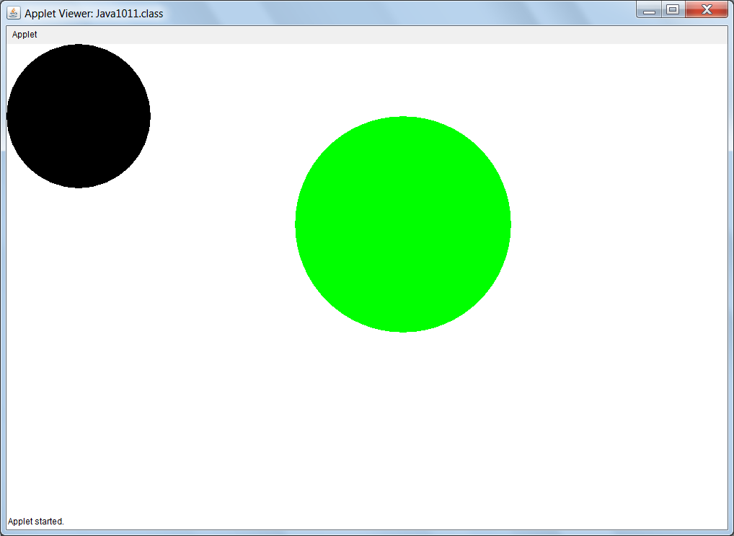

Slide 38
// Java1012.java
// The <Leaves> class is now complete with four
// "get" methods and four "set" methods.
import java.awt.*;
import java.applet.*;
public class Java1012 extends Applet
{
public void paint(Graphics g)
{
Leaves leaves1 = new Leaves();
leaves1.drawLeaves(g);
Point start = new Point(400,100);
Leaves leaves2 = new Leaves(start,300,300,Color.green);
leaves2.drawLeaves(g);
}
}

Slide 39

class Leaves
{
public Leaves(Point lS, int lW, int lH, Color lC)
{
leavesStart = lS;
leavesWidth = lW;
leavesHeight = lH;
leavesColor = lC;
}
public Point getLeavesStart() { return leavesStart; }
public int getLeavesHeight() { return leavesHeight; }
public int getLeavesWidth() { return leavesWidth; }
public Color getLeavesColor() { return leavesColor; }
public void setLeavesStart(Point lP) { leavesStart = lP; }
public void setLeavesHeight(int lH) { leavesHeight = lH; }
public void setLeavesWidth(int lW) { leavesWidth = lW; }
public void setLeavesColor(Color lC) { leavesColor = lC; }
public void drawLeaves(Graphics g)
{
g.setColor(leavesColor);
g.fillOval(leavesStart.getX(),leavesStart.getY(),leavesWidth,leavesHeight);
}
}
private Point leavesStart;
private int leavesWidth;
private int leavesHeight;
private Color leavesColor;
public Leaves()
{
leavesStart = new Point(0,0);
leavesWidth = 200;
leavesHeight = 200;
leavesColor = Color.black;
}

Slide 40
// Java1013.java
// The <Leaves> class joins the <Point> class and <Trunk> class.
// as a stand-alone class ready to be used by other classes.
import java.awt.*;
import java.applet.*;
public class Java1013 extends Applet
{
public void paint(Graphics g)
{
Leaves leaves1 = new Leaves();
leaves1.drawLeaves(g);
Point start = new Point(400,100);
Leaves leaves2 = new Leaves(start,300,300,Color.blue);
leaves2.drawLeaves(g);
}
}

Slide 41

// Leaves.java
// This is the completed <Leaves> class kept in its own file.
// This class is now ready to be used by classes external to this file.
import java.awt.*;
public class Leaves
{
public Leaves(Point lS, int lW, int lH, Color lC)
{
leavesStart = lS;
leavesWidth = lW;
leavesHeight = lH;
leavesColor = lC;
}
public Point getLeavesStart() { return leavesStart; }
public int getLeavesHeight() { return leavesHeight; }
public int getLeavesWidth() { return leavesWidth; }
public Color getLeavesColor() { return leavesColor; }
public void setLeavesStart(Point lP) { leavesStart = lP; }
public void setLeavesHeight(int lH) { leavesHeight = lH; }
public void setLeavesWidth(int lW) { leavesWidth = lW; }
public void setLeavesColor(Color lC) { leavesColor = lC; }
public void drawLeaves(Graphics g)
{
g.setColor(leavesColor);
g.fillOval(leavesStart.getX(),leavesStart.getY(),leavesWidth,leavesHeight);
}
}
private Point leavesStart;
private int leavesWidth;
private int leavesHeight;
private Color leavesColor;
public Leaves()
{
leavesStart = new Point(0,0);
leavesWidth = 200;
leavesHeight = 200;
leavesColor = Color.black;
}

Slide 42
Section 10.5
Class Interaction
with Composition

Slide 43
// Java1014.java
// The <Tree> class uses the three stand-alone classes:
// <Point>, <Trunk> and <Leaves> to draw a tree.
// This <Tree> class "has" three attributes that are objects
// using a composition class-interaction.
import java.awt.*;
import java.applet.*;
public class Java1014 extends Applet
{
public void paint(Graphics g)
{
Point treeStart = new Point(500,200);
int treeHeight = 500;
int treeWidth = 300;
Color trunkColor = new Color(150,100,15); // brown
Color leavesColor = Color.green;
Tree tree = new Tree(treeStart,treeHeight,treeWidth, trunkColor, leavesColor);
tree.drawTree(g);
}
}

Slide 44

class Tree
{
private Point treeStart; // Top-mid (X,Y) coordinates of the tree
private Point leavesStart; // Top-left (X,Y) coordinates of the leaves
private Point trunkStart; // Top-left (X,Y) coordinates of the trunk
private int treeHeight;
private int treeWidth;
private Color trunkColor;
private Color leavesColor;
private int leavesHeight;
private int leavesWidth;
private int trunkHeight;
private int trunkWidth;
private Trunk trunk; // A tree "has-a" trunk
private Leaves leaves; // A tree "has" leaves

Slide 45
public Tree(Point tS, int tH, int tW, Color tC, Color lC)
{
treeStart = tS;
treeHeight = tH;
treeWidth = tW;
trunkColor = tC;
leavesColor = lC;
leavesHeight = treeWidth;
leavesWidth = treeWidth;
trunkHeight = treeHeight - leavesHeight;
trunkWidth = trunkHeight/4;
trunkStart = new
Point(treeStart.getX()-(trunkWidth/2),treeStart.getY()+leavesHeight-3);
leavesStart = new Point(treeStart.getX()-(leavesWidth/2),treeStart.getY());
trunk = new Trunk(trunkStart,trunkWidth,trunkHeight,trunkColor);
leaves = new Leaves(leavesStart,leavesWidth,leavesHeight,leavesColor);
}
public void drawTree(Graphics g)
{
trunk.drawTrunk(g);
leaves.drawLeaves(g);
}
}

Slide 46
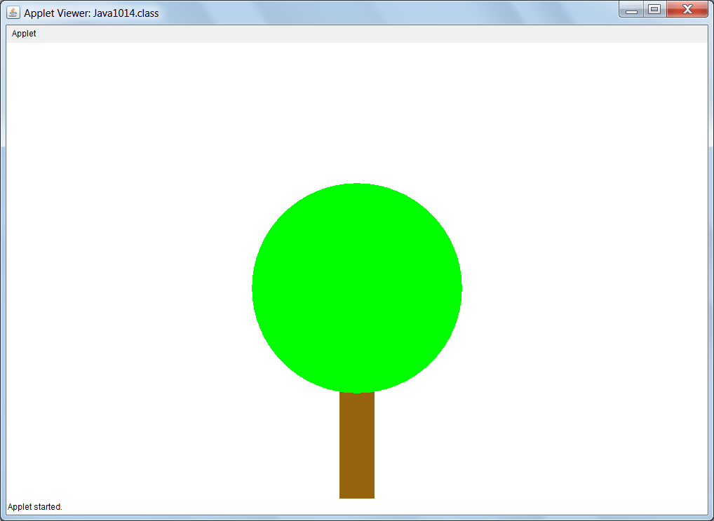

Slide 47
// Java1015.java
// This version of the <Tree> class does not use
// attributes that are <Trunk> and <Leaves> objects.
// The <Tree> class also adds a default constructor.
import java.awt.*;
import java.applet.*;
public class Java1015 extends Applet
{
public void paint(Graphics g)
{
Tree tree1 = new Tree();
tree1.drawTree(g);
Point treeStart = new Point(700,50);
Tree tree2 = new Tree(treeStart,400,200,Color.blue,Color.red);
tree2.drawTree(g);
}
}

Slide 48

class Tree
{
private Point treeStart; // Top-mid (X,Y) coordinates of the tree
private Point leavesStart; // Top-left (X,Y) coordinates of the leaves
private Point trunkStart; // Top-left (X,Y) coordinates of the trunk
private int treeHeight;
private int treeWidth;
private Color trunkColor;
private Color leavesColor;
private int leavesHeight;
private int leavesWidth;
private int trunkHeight;
private int trunkWidth;

Slide 49
public Tree()
{
treeStart = new Point(400,100);
treeHeight = 500;
treeWidth = 300;
trunkColor = Color.black;
leavesColor = Color.black;
leavesHeight = treeWidth;
leavesWidth = treeWidth;;
trunkHeight = treeHeight - leavesHeight;
trunkWidth = trunkHeight/4;
leavesStart = new Point(treeStart.getX()-(leavesWidth/2),treeStart.getY());
trunkStart = new Point(treeStart.getX()-(trunkWidth/2),treeStart.getY()+leavesHeight-3);
}
public Tree(Point tS, int tH, int tW, Color tC, Color lC)
{
treeStart = tS;
treeHeight = tH;
treeWidth = tW;
trunkColor = tC;
leavesColor = lC;
leavesHeight = treeWidth;
leavesWidth = treeWidth;;
trunkHeight = treeHeight - leavesHeight;
trunkWidth = trunkHeight/4;
leavesStart = new Point(treeStart.getX()-(leavesWidth/2),treeStart.getY());
trunkStart = new Point(treeStart.getX()-(trunkWidth/2),treeStart.getY()+leavesHeight-3);
}

Slide 50
public void drawLeaves(Graphics g)
{
g.setColor(leavesColor);
g.fillOval(leavesStart.getX(),leavesStart.getY(),leavesWidth,leavesHeight);
}
public void drawTrunk(Graphics g)
{
g.setColor(trunkColor);
g.fillRect(trunkStart.getX(),trunkStart.getY(),trunkWidth,trunkHeight);
}
public void drawTree(Graphics g)
{
drawLeaves(g);
drawTrunk(g);
}
}

Slide 51
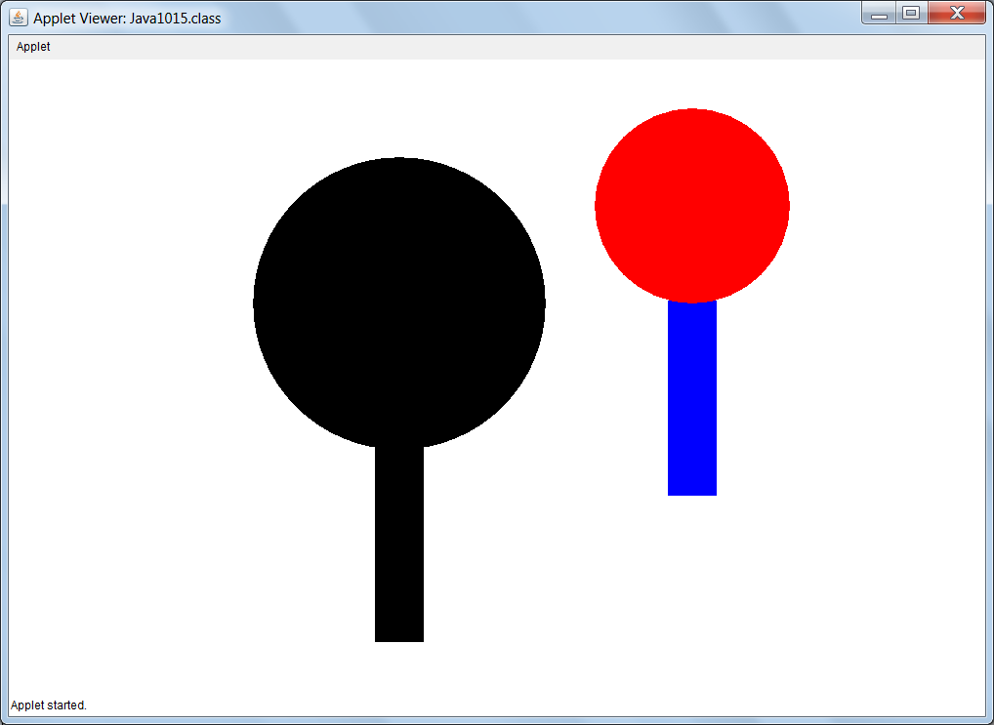

Slide 52
Section 10.6
Class Interaction
with Inheritance

Slide 53
Inheritance Fundamentals
A subclass can re-define one or more methods of the superclass. This is also called over-riding a method.
A subclass can newly-define one or more methods.
A subclass can be completely empty.
Nothing is re-defined or newly-defined.
In such a case there is no apparent difference between
the super class behavior and the subclass behavior.
When a subclass re-defines one or more methods or
newly-defines one or more method, it still has access to
all of the superclass methods that were not re-defined.

Slide 54
// Java1016.java
// The programs will now investigate inheritance class-interaction.
// The <Tree> class is placed in an external file
// with a group of "get" and "set" methods and will
// be the superclass for various new subclasses.
import java.awt.*;
import java.applet.*;
public class Java1016 extends Applet
{
public void paint(Graphics g)
{
Tree tree = new Tree();
tree.drawTree(g);
}
}

Slide 55
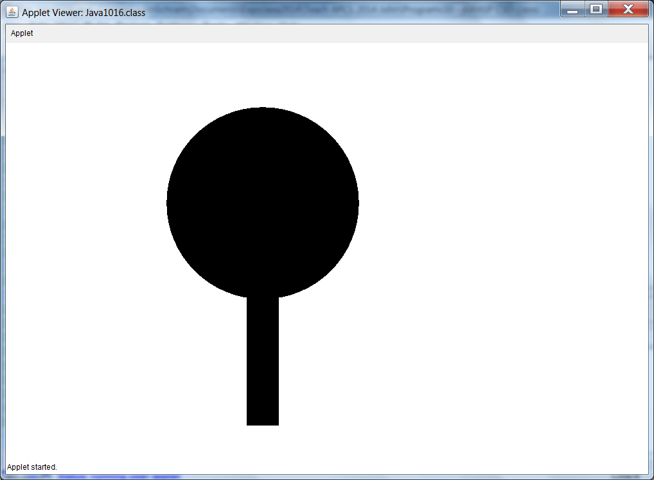

Slide 56
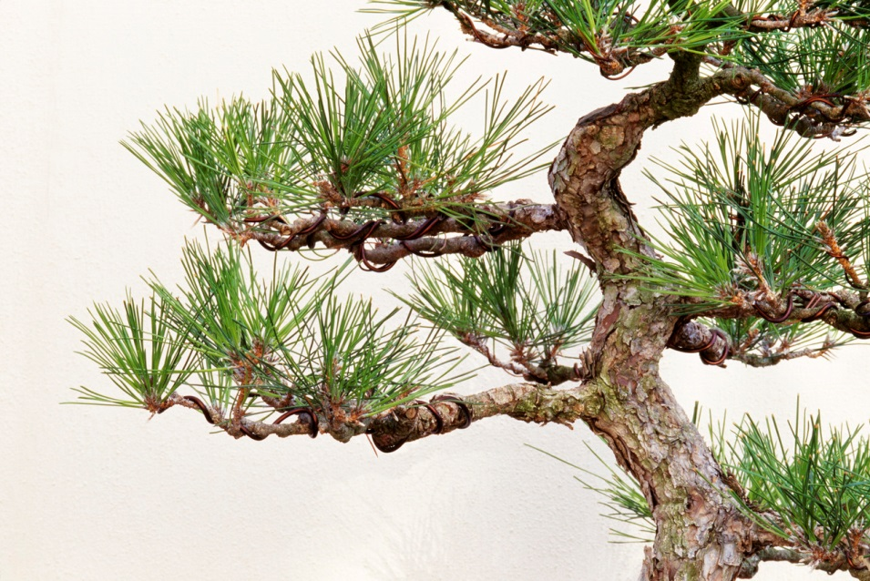
// Tree.java
// This is the completed <Trunk> class kept in its own file.
// The class is now ready to be used by classes external to this file.
// This <Tree> class will be the superclass for later programs.
import java.awt.*;
public class Tree
{
private Point treeStart; // Top-mid (X,Y) coordinates of the tree
private Point leavesStart; // Top-left (X,Y) coordinates of the leaves
private Point trunkStart; // Top-left (X,Y) coordinates of the trunk
private int treeHeight;
private int treeWidth;
private Color trunkColor;
private Color leavesColor;
private int leavesHeight;
private int leavesWidth;
private int trunkHeight;
private int trunkWidth;

Slide 57
public Tree()
{
treeStart = new Point(400,100);
treeHeight = 500;
treeWidth = 300;
trunkColor = Color.black;
leavesColor = Color.black;
leavesHeight = treeWidth;
leavesWidth = treeWidth;;
trunkHeight = treeHeight - leavesHeight;
trunkWidth = trunkHeight/4;
leavesStart = new Point(treeStart.getX()-(leavesWidth/2),treeStart.getY());
trunkStart = new Point(treeStart.getX()-(trunkWidth/2),treeStart.getY()+leavesHeight-3);
}
public Tree(Point tS, int tH, int tW, Color tC, Color lC)
{
treeStart = tS;
treeHeight = tH;
treeWidth = tW;
trunkColor = tC;
leavesColor = lC;
leavesHeight = treeWidth;
leavesWidth = treeWidth;;
trunkHeight = treeHeight - leavesHeight;
trunkWidth = trunkHeight/4;
leavesStart = new Point(treeStart.getX()-(leavesWidth/2),treeStart.getY());
trunkStart = new Point(treeStart.getX()-(trunkWidth/2),treeStart.getY()+leavesHeight-3);
}

Slide 58
public Point getTreeStart() { return treeStart; }
public Point getLeavesStart() { return leavesStart; }
public Point getTrunkStart() { return trunkStart; }
public int getTreeHeight() { return treeHeight; }
public int getTreeWidth() { return treeWidth; }
public Color getTrunkColor() { return trunkColor; }
public Color getLeavesColor() { return leavesColor; }
public int getLeavesHeight() { return leavesHeight;}
public int getLeavesWidth() { return leavesWidth; }
public int getTrunkHeight() { return trunkHeight; }
public int getTrunkWidth() { return trunkWidth; }
public void setTreeStart(Point tP) { treeStart = tP; }
public void setLeavesStart(Point lP) { leavesStart = lP; }
public void setTrunkStart(Point tP) { trunkStart = tP; }
public void setTreeHeight(int tH) { treeHeight = tH; }
public void setTreeWidth(int tW) { treeWidth = tW; }
public void setTrunkColor(Color tC) { trunkColor = tC; }
public void setLeavesColor(Color lC) { leavesColor = lC; }
public void setLeavesHeight(int lH) { leavesHeight = lH;}
public void setLeavesWidth(int lW) { leavesWidth = lW; }
public void setTrunkHeight(int tH) { trunkHeight = tH; }
public void setTrunkWidth(int tW) { trunkWidth = tW; }

Slide 59
public void drawLeaves(Graphics g)
{
g.setColor(leavesColor);
g.fillOval(leavesStart.getX(),leavesStart.getY(),leavesWidth,leavesHeight);
}
public void drawTrunk(Graphics g)
{
g.setColor(trunkColor);
g.fillRect(trunkStart.getX(),trunkStart.getY(),trunkWidth,trunkHeight);
}
public void drawTree(Graphics g)
{
drawLeaves(g);
drawTrunk(g);
}
}

Slide 60
// Java1017.java
// The <SubTree1> class extends the <Tree> class
// without re-defining or newly-defining any methods.
// The resulting tree display is identical to its superclass version.
import java.awt.*;
import java.applet.*;
public class Java1017 extends Applet
{
public void paint(Graphics g)
{
SubTree1 tree1 = new SubTree1();
tree1.drawTree(g);
}
}
class SubTree1 extends Tree
{
}

Slide 61


Slide 62
// Java1018.java
// The <SubTree2> class extends the <Tree> class
// and defines a <SubTree2> constructor to change the <leavesColor>.
import java.awt.*;
import java.applet.*;
public class Java1018 extends Applet
{
public void paint(Graphics g)
{
SubTree2 tree2 = new SubTree2();
tree2.drawTree(g);
}
}
class SubTree2 extends Tree
{
public SubTree2() { setLeavesColor(Color.green); }
}

Slide 63
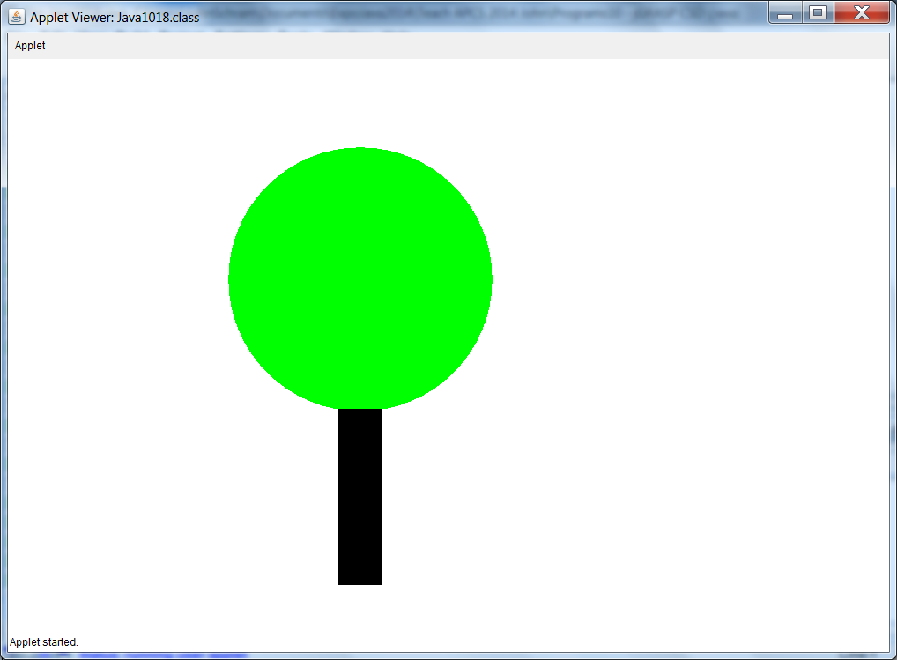

Slide 64
// Java1019.java
// The <PineTree> class extends the <Tree> class
// and re-defines the <drawLeaves> method.
import java.awt.*;
import java.applet.*;
public class Java1019 extends Applet
{
public void paint(Graphics g)
{
PineTree tree3 = new PineTree();
tree3.drawTree(g);
}
}

Slide 65
class PineTree extends Tree
{
public PineTree() { setLeavesColor(Color.green); }
public void drawLeaves(Graphics g)
{
g.setColor(getLeavesColor());
int tempX = getLeavesStart().getX();
int tempY = getLeavesStart().getY();
int topX = tempX + getLeavesWidth()/2;
int topY = tempY;
int blX = tempX;
int blY = tempY + getLeavesHeight();
int brX = tempX + getLeavesWidth();
int brY = tempY + getLeavesHeight();
Polygon triangle = new Polygon();
triangle.addPoint(topX,topY);
triangle.addPoint(blX,blY);
triangle.addPoint(brX,brY);
g.fillPolygon(triangle);
}
}

Slide 66
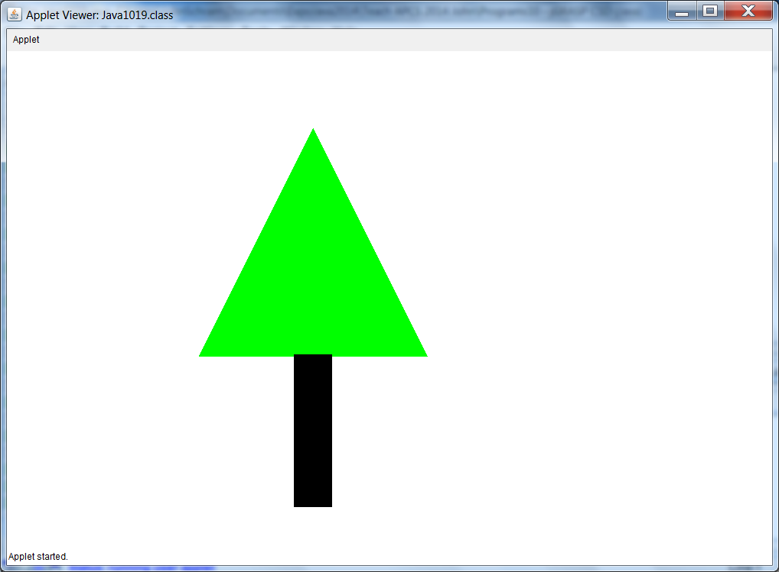

Slide 67
Subclass Methods
Never alter a well-designed, and tested, existing class.
Write a new subclass class to use the methods of the existing class and create new methods in your new class.
Write methods in the subclass that are re-definitions
of the existing superclass methods or write totally new-definitions.

Slide 68
// Java1020.java
// The <XmasTree> class extends the <PineTree> class
// and newly-defines the <drawOrnaments> method.
import java.awt.*;
import java.applet.*;
public class Java1020 extends Applet
{
public void paint(Graphics g)
{
XmasTree tree4 = new XmasTree();
tree4.drawTree(g);
tree4.drawOrnaments(g);
}
}

Slide 69
class XmasTree extends PineTree
{
private int topX;
private int topY;
public XmasTree()
{
topX = getLeavesStart().getX() + getLeavesWidth()/2;
topY = getLeavesStart().getY();
}
public void drawOrnaments(Graphics g)
{
g.setColor(Color.red);
g.fillOval(topX,topY+75,30,30);
g.fillOval(topX-15,topY-15,30,30);
g.fillOval(topX,topY+200,30,30);
g.fillOval(topX-50,topY+150,30,30);
g.fillOval(topX+50,topY+250,30,30);
g.fillOval(topX-100,topY+250,30,30);
}
}
class PineTree extends Tree // same as the previous program

Slide 70


Slide 71
Multi-Level Inheritance
& Multiple Inheritance
The previous program showed an example of Multi-Level Inheritance.
Multiple Inheritance is something different. It occurs when one subclass inherits from two or more superclasses.
This feature is available in C++.
It is NOT available in Java.

Slide 72
Multi-Level Inheritance | Multiple Inheritance
Animal
Reptile
Extinct
Mammal
Dinosaur
Dog
Terrier

Slide 73
Section 10.7
Inheritance
Constructor Issues

Slide 74
Section 10.7
Inheritance
Constructor Issues

Slide 75
// Java1021.java
// Note: The <Person> constructor is called, even though there does
// not appear to be a <Person> object instantiated.
public class Java1021
{
public static void main(String args[])
{
Student tom = new Student();
System.out.println("tom's age is " + tom.getAge());
System.out.println("tom's grade is " + tom.getGrade());
}
}
class Person
{
private int age;
public Person() { System.out.println("Person Constructor"); age = 17; }
public int getAge() { return age; }
}
class Student extends Person
{
private int grade;
public Student() { System.out.println("Student Constructor"); grade = 12; }
public int getGrade() { return grade; }
}
Person Constructor
Student Constructor
tom's age is 17
tom's grade is 12

Slide 76

// Java1022.java
// This program adds a call to <super> in the <Student> constructor.
// The program output is identical to the previous program.
// Java automatically makes the call to <super>.
public class Java1022
{
public static void main(String args[])
{
Student tom = new Student();
System.out.println("tom's age is " + tom.getAge());
System.out.println("tom's grade is " + tom.getGrade());
}
}
class Person // same as the previous program
public Student()
{
super(); // must be first statement in the constructor
System.out.println("Student Constructor");
grade = 12;
}

Slide 77
Inheritance and
Constructor Calls
When an object of a subclass is instantiated, the constructor of the superclass is executed first, followed by completing the execution of the subclass constructor.
An invisible - to the programmer - call is made by Java to the super method, which generates a call to the superclass constructor.
This statement can be written in the subclass constructor with the same results, but it is not required.

Slide 78
class Student extends Person
{
private int grade;
public Student()
{
super(); // not required; Java makes this call
System.out.println("Student Constructor");
grade = 12;
}
public int getGrade()
{
return grade;
}
}

Slide 79
// Java1023.java
// This program demonstrates how a subclass constructor passes
// parameter information to a superclass constructor.
public class Java1023
{
public static void main(String args[])
{
Student tom = new Student(12,17);
tom.showData();
}
}
class Person
{
private int age;
public Person(int a)
{
System.out.println("Person Parameter Constructor");
age = a;
}
public int getAge() { return age; }
}
Person Parameter Constructor
Student Parameter Constructor
Student's Grade is 12
Student's Age is 17

Slide 80
class Student extends Person
{
private int grade;
public Student(int g, int a)
{
super(a); // required for superclass parameter constructors
grade = g;
System.out.println("Student Parameter Constructor");
}
public int getGrade()
{
return grade;
}
public void showData()
{
System.out.println("Student's Grade is " + getGrade());
System.out.println("Student's Age is " + getAge());
}
}

Slide 81
// Java1024.java This program demonstrates inheritance at three levels.
public class Java1024 { public static void main(String args[]) { Cat tiger = new Cat("Tiger",500,5); System.out.println(); System.out.println("Animal type: " + tiger.getType()); System.out.println("Animal weight: " + tiger.getWeight()); System.out.println("Animal age: " + tiger.getAge()); } } class Animal { private int age; public Animal(int a) { System.out.println("Animal Constructor Called"); age = a; } public int getAge() { return age; } } | class Mammal extends Animal { private int weight; public Mammal(int w, int a) { super(a); weight = w; System.out.println( "Mammal Constructor Called"); } public int getWeight() { return weight; } } class Cat extends Mammal { private String type; public Cat(String t, int w, int a) { super(w,a); type = t; System.out.println( "Cat Constructor Called"); } public String getType() { return type; } }
Animal Constructor Called
Mammal Constructor Called
Cat Constructor Called
Animal type: Tiger
Animal weight: 500
Animal age: 5

Slide 82
Section 10.8
Calling a
Superclass
Method

Slide 83
// Java1025.java
// This program demonstrates that it is possible to distinguish between
// two methods with the same identifier using <super>.
public class Java1025
{
public static void main(String args[])
{
Student tom = new Student(12,17);
tom.showData();
}
}
class Person
{
private int age;
public Person(int a)
{
System.out.println("Person Parameter Constructor");
age = a;
}
public int getData() { return age; }
}

Slide 84
class Student extends Person
{
private int grade;
public Student(int g, int a)
{
super(a);
grade = g;
System.out.println("Student Parameter Constructor");
}
public int getData() { return grade; }
public void showData()
{
System.out.println("Student's Grade is " + getData());
System.out.println("Student's Age is " + super.getData());
}
}

Slide 85
Using super
The keyword super used as the first statement in a constructor passes information to the super class constructor, like super(a);
The same keyword super used in front of a method indicates that a method of the superclass needs to be called, like super.getData();
Information can be passed up to multiple inheritance levels, but it can only be passed one level at one time.

Slide 86
Section 10.9
The Object Class

Slide 87
// Java1026.java
// This program intentional extends the two classes with
// Object as the superclass. This is done automatically.
public class Java1026 extends Object
{
public static void main (String args[])
{
Qwerty q = new Qwerty();
}
}
class Qwerty extends Object
{
public Qwerty()
{
System.out.println("Constructing Qwerty Object");
}
}
Constructing Qwerty Object

Slide 88
// Java1027.java
// This demonstrates how <String> class objects are printed.
public class Java1027
{
public static void main (String args[])
{
String stringVar = "Tango";
System.out.println(stringVar);
System.out.println();
System.out.println("Literal String");
System.out.println();
}
}
Tango
Literal String

Slide 89
// Java1028.java
// This demonstrates how <int>, <double>, <char> and <boolean>
// variables are printed.
public class Java1028
{
public static void main (String args[])
{
int intVar = 100;
double dblVar = 3.14159;
char chrVar = 'A';
boolean blnVar = true;
System.out.println(intVar);
System.out.println(dblVar);
System.out.println(chrVar);
System.out.println(blnVar);
System.out.println();
}
}
100
3.14159
A
true

Slide 90
// Java1029.java
// In this program objects of a user-defined <Student> class are used with <print> statement.
public class Java1029
{
public static void main (String[] args)
{
Student tom = new Student(21,3.85);
Student sue = new Student(17,3.65);
Student bob = new Student(18,2.85);
System.out.println("tom: " + tom);
System.out.println("sue: " + sue);
System.out.println("bob: " + bob);
}
}
class Student
{
private int age;
private double gpa;
public Student(int a, double g)
{
age = a;
gpa = g;
}
}
tom: Student@1db9742
sue: Student@106d69c
bob: Student@52e922

Slide 91
Java1029 Graphic
tom
@1db9742
sue
@106d69c
bob
@52e922
1db9742
21 | 3.85
106d69c
17 | 3.65
52e922
18 | 2.85
Each Student variable is storing
the memory address of its object.

Slide 92
// Java1030.java
// Each println statement includes a call to the <toString> method, which is defined to return the
// shallow value of the object.
public class Java1029
{
public static void main (String[] args)
{
Student tom = new Student(21,3.85);
Student sue = new Student(17,3.65);
Student bob = new Student(18,2.85);
System.out.println("tom: " + tom.toString());
System.out.println("sue: " + sue.toString());
System.out.println("bob: " + bob.toString());
}
}
class Student
{
private int age;
private double gpa;
public Student(int a, double g)
{
age = a;
gpa = g;
}
}
tom: Student@1db9742
sue: Student@106d69c
bob: Student@52e922

Slide 93
The Original toString Method
print and println request display instructions from the toString method.
Method toString is defined by the Object class.
The Object class is the superclass for all Java classes.
This means that every class has access to the toString method.
The toString method, as defined by the Object class, returns the actual string representation values of all the primitive types like int, double, char and boolean.
toString returns the class name followed by the memory reference of any variable object.

Slide 94
“The mother of all classes”
All classes automatically inherit from
The Object Class
Object
toString
equals
Student
String
System
Qwerty
All other classes

Slide 95
Section 10.10
Redefining the
toString Method

Slide 96
// Java1031.java
// Each println statement includes a call to the <toString> method, which is defined to
// return the shallow value of the object.
public class Java1031
{
public static void main (String[] args)
{
Student tom = new Student(21,3.85);
Student sue = new Student(17,3.65);
Student bob = new Student(18,2.85);
System.out.println("tom: " + tom);
System.out.println("sue: " + sue);
System.out.println("bob: " + bob);
}
}
class Student
{
private int age;
private double gpa;
public Student(int a, double g)
{
age = a;
gpa = g;
}
public String toString()
{
return "" + age;
}
}
tom: 21
sue: 17
bob: 18
NOTE: return age; would not compile because a String value must be returned. return String.valueOf(age); would also work.

Slide 97
// Java1032.java
// The <toString> method is re-defined to return all the
// attribute values in the [Tom, 21, 3.85] format.
public class Java1032
{
public static void main (String[] args)
{
Student student1 = new Student("Tom",21,3.85);
Student student2 = new Student("Sue",17,3.65);
Student student3 = new Student("Bob",18,2.85);
System.out.println(student1);
System.out.println(student2);
System.out.println(student3);
}
}
class Student
{
public String toString()
{
return "[" + name + ", " + age + ", " + gpa + "]";
}
// The rest of the Student class is the same as before.
[Tom, 21, 3.85]
[Sue, 17, 3.65]
[Bob, 18, 2.85]

Slide 98
// Java1033.java
// The <toString> method is re-defined to always return
// the "Aardvark" string, regardless of the attribute values.
public class Java1033
{
public static void main (String[] args)
{
Student student1 = new Student("Tom",21,3.85);
Student student2 = new Student("Sue",17,3.65);
Student student3 = new Student("Bob",18,2.85);
System.out.println(student1);
System.out.println(student2);
System.out.println(student3);
}
}
class Student
{
public String toString()
{
return "Aardvark";
}
// The rest of the Student class is the same as before.
Aardvark
Aardvark
Aardvark

Slide 99
Section 10.11
Redefining the
equals Method

Slide 100
Person class used in the next several programs
class Person
{
private String name;
private int age;
private char gender;
private double salary;
public Person(String n, int a, char g, double s)
{
name = n;
age = a;
gender = g;
salary = s;
}
public String toString()
{
return "[" + name + ", " + age + ", " + gender + ", " + salary + "]";
}
}

Slide 101
// Java1034.java
// This program tries to compares 2 person objects with the == operator.
// This does not work because the == operator only checks the shallow value.
// It also does not give us a way to determine how we will check for equality.
public class Java1034
{
public static void main (String args[])
{
Person tom = new Person("Tom Jones",36,'M',40000);
Person sue = new Person("Sue Smith",29,'F',50000);
Person bob = new Person("Bob Brown",40,'M',50000);
System.out.println(tom);
System.out.println(sue);
System.out.println(bob);
System.out.println();
if (tom == sue)
System.out.println("Tom and Sue are equal.");
else
System.out.println("Tom and Sue are not equal.");
if (tom == bob)
System.out.println("Tom and Bob are equal.");
else
System.out.println("Tom and Bob are not equal.");
if (sue == bob)
System.out.println("Sue and Bob are equal.");
else
System.out.println("Sue and Bob are not equal.");
}
}
[Tom Jones, 36, M, 40000.0]
[Sue Smith, 29, F, 50000.0]
[Bob Brown, 40, M, 50000.0]
Tom and Sue are not equal.
Tom and Bob are not equal.
Sue and Bob are not equal.

Slide 102
Java1034 Graphic
tom
@16f0472
bob
@18d107f
sue
@3b0eb0
16f0472
Tom Jones | 36
$40,000.00 | ‘M’
18d107f
Sue Smith | 29
$50,000.00 | ‘F’
3b0eb0
Bob Brown | 40
$50,000.00 | ‘M’
The == operator is comparing the memory addresses,
just like it did with Strings.

Slide 103
// Java1035.java
// This program tries to compare 2 person objects with the equals method. This also does not work
// because we have not "re-defined" the equals method for the Person class, and we are simply
// inheriting the equals method from the Object class, which only checks the shallow value.
public class Java1035
{
public static void main (String args[])
{
Person tom = new Person("Tom Jones",36,'M',40000);
Person sue = new Person("Sue Smith",29,'F',50000);
Person bob = new Person("Bob Brown",40,'M',50000);
System.out.println(tom);
System.out.println(sue);
System.out.println(bob);
System.out.println();
if (tom.equals(sue))
System.out.println("Tom and Sue are equal.");
else
System.out.println("Tom and Sue are not equal.");
if (tom.equals(bob))
System.out.println("Tom and Bob are equal.");
else
System.out.println("Tom and Bob are not equal.");
if (sue.equals(bob))
System.out.println("Sue and Bob are equal.");
else
System.out.println("Sue and Bob are not equal.");
}
}
[Tom Jones, 36, M, 40000.0]
[Sue Smith, 29, F, 50000.0]
[Bob Brown, 40, M, 50000.0]
Tom and Sue are not equal.
Tom and Bob are not equal.
Sue and Bob are not equal.

Slide 104
Java1035 Graphic
tom
@16f0472
bob
@18d107f
sue
@3b0eb0
16f0472
Tom Jones | 36
$40,000.00 | ‘M’
18d107f
Sue Smith | 29
$50,000.00 | ‘F’
3b0eb0
Bob Brown | 40
$50,000.00 | ‘M’
While String has its own equals method, Person does not.
The result is we are using the equals method from the
Object class which also compares memory addresses.

Slide 105
// Java1036.java
// This program properly compares 2 person objects with the re-defined equals method.
// It chooses to define "equality" solely based on a Person's salary, which may be
// overly capitalistic, but still makes a point.
public class Java1036
{
public static void main (String args[])
{
Person tom = new Person("Tom Jones",36,'M',40000);
Person sue = new Person("Sue Smith",29,'F',50000);
Person bob = new Person("Bob Brown",40,'M',50000);
System.out.println(tom);
System.out.println(sue);
System.out.println(bob);
System.out.println();
if (tom.equals(sue))
System.out.println("Tom and Sue are equal.");
else
System.out.println("Tom and Sue are not equal.");
if (tom.equals(bob))
System.out.println("Tom and Bob are equal.");
else
System.out.println("Tom and Bob are not equal.");
if (sue.equals(bob))
System.out.println("Sue and Bob are equal.");
else
System.out.println("Sue and Bob are not equal.");
}
}

Slide 106
class Person
{
private String name;
private int age;
private char gender;
private double salary;
public Person(String n, int a, char g, double s)
{
name = n;
age = a;
gender = g;
salary = s;
}
public String toString()
{
return "[" + name + ", " + age + ", " + gender + ", " + salary + "]";
}
public boolean equals(Person temp)
{
return salary == temp.salary;
}
}
[Tom Jones, 36, M, 40000.0]
[Sue Smith, 29, F, 50000.0]
[Bob Brown, 40, M, 50000.0]
Tom and Sue are not equal.
Tom and Bob are not equal.
Sue and Bob are equal.

Slide 107
Java1036 Graphic
tom
@16f0472
bob
@18d107f
sue
@3b0eb0
16f0472
Tom Jones | 36
$40,000.00 | ‘M’
18d107f
Sue Smith | 29
$50,000.00 | ‘F’
3b0eb0
Bob Brown | 40
$50,000.00 | ‘M’
Now Person has its own equals method.
We chose to define equality based on salary.

Slide 108
// Java1037.java
// This program defines equality differently from the previous programs.
// Now all data fields must match for 2 Person objects to be considered equal.
// A special <this> reference in the equals method helps to distinguish the 2 objects.
// NOTE: It is not uncommon for the equals method from one class to call the
// equals method from another class.
public boolean equals(Person that)
{
return this.name.equals(that.name) &&
this.age == that.age &&
this.gender == that.gender &&
this.salary == that.salary;
}
[Tom Jones, 36, M, 40000.0]
[Sue Smith, 29, F, 50000.0]
[Bob Brown, 40, M, 50000.0]
Tom and Sue are not equal.
Tom and Bob are not equal.
Sue and Bob are not equal.

Slide 109
Java1037 Graphic
tom
@16f0472
bob
@18d107f
sue
@3b0eb0
16f0472
Tom Jones | 36
$40,000.00 | ‘M’
18d107f
Sue Smith | 29
$50,000.00 | ‘F’
3b0eb0
Bob Brown | 40
$50,000.00 | ‘M’
In this case, the re-defined equals method
bases equality on all 4 fields in the record.

Slide 110
Re-defining vs. Overloading equals
The heading of the equals method in superclass Object is as follows:
The headings of the last two programs are as follows:
While the previous 2 programs seemed to work, we did not actually re-define equals method of the Object class.
Instead, each program created an overloaded equals method with a Person object parameter.
To properly re-define equals, it needs to have an Object parameter, just like it does in the Object class.
public boolean equals(Object other)
public boolean equals(Person temp)
public boolean equals(Person that)

Slide 111
// Java1038.java
// This program shows the correct re-definition of the <equals> method.
// The heading uses <Object> and requires class casting.
public boolean equals(Object that)
{
return this.salary == ( (Person) that).salary;
}
[Tom Jones, 36, M, 40000.0]
[Sue Smith, 29, F, 50000.0]
[Bob Brown, 40, M, 50000.0]
Tom and Sue are not equal.
Tom and Bob are not equal.
Sue and Bob are equal.
NOTE: The Java compiler uses something similar to “Order of Operations”. Without the extra (parentheses) it would attempt to cast the salary attribute as a Person object.

